Slide 1
Recitation #4
17-356/17-766

Slide 2
TAs
Mehul Agarwal
email: mehula@andrew.cmu.edu
office hours: Wednesdays 3:30 - 4:30 PM
Rohit Shreenivas
email: rshreeni@andrew.cmu.edu
office hours: Fridays 5 - 6 PM

Slide 3
Full-stack Development
Different levels of the stack:
Backend
Frontend
Database
Deployment
Testing
and more
Today’s topic

Slide 4
USING TYPESCRIPT WITH REACT

Slide 5
What and Why Typescript?
TypeScript is a strongly typed, object-oriented, compiled programming language that builds on JavaScript
Provides an easy way to structure your objects and enforce type validation on them
Provides great tooling in your IDEs which help catch bugs that potentially would have otherwise been caught in deployment
0 learning curve if you already know JS

Slide 6
Install TS
To install TS globally:
npm i -g typescript
tsc --version
To create a react-typescript project:
npx create-react-app . → plain react app
npx create-react-app <project-name> --template typescript

Slide 7
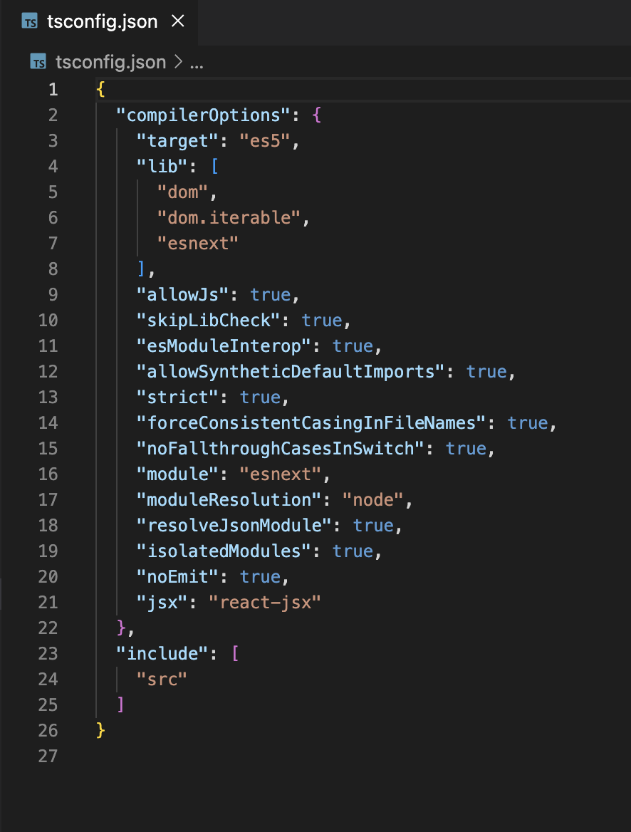
tsconfig.json
The presence of a tsconfig.json file in a directory indicates that the directory is the root of a TypeScript project.
The tsconfig.json file specifies the root files and the compiler options required to compile the project.

Slide 8
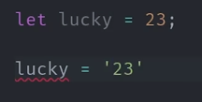
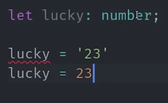
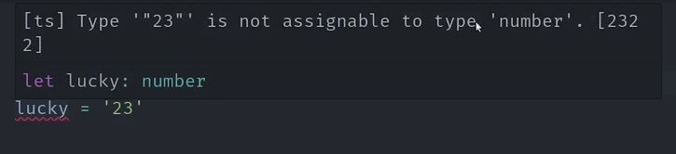
How to make your variables strongly typed
Notes:
When we initialize a variable with a value, it picks the type of the value assigned to it - This is one of doing it
To explicitly assign a type, use “:” next to the variable name and specify the type
Once this is done, hover over the variable to see its type

Slide 9
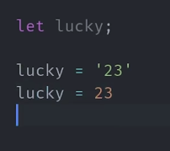
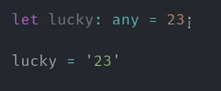
NOT A GREAT PRACTICE!
Notes:
To make variable take any type of data, use “any” OR do not assign a value at the time of declaration - Not a great practice!

Slide 10
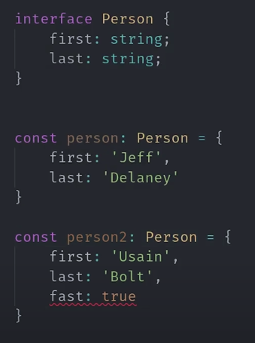
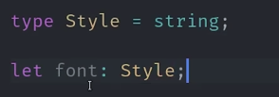
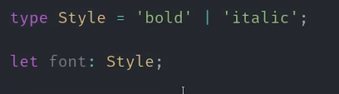
Creating custom types
Notes:
keywords “type” and “interface” can be used to create custom types
when to use types/interfaces
types - while building apps
interface - while building libs
in recent versions they can be used interchangeably without any issues
you can also make union of multiple types using ‘|’
to allow flexibility in the interface while maintaining the required properties, we add additional optional key - shown on the next slide

Slide 11
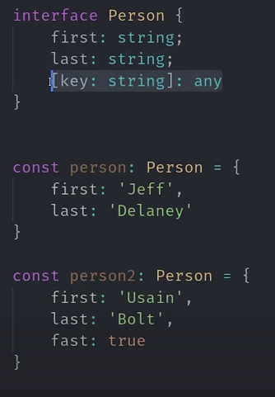

Slide 12
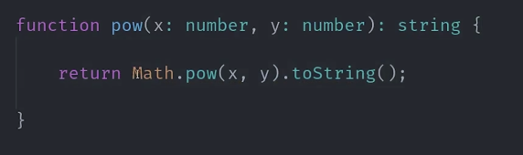
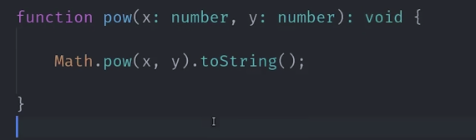
Strong typing a function
Notes:
we can specify the types for function parameters as well as the return types
we use return type void majorly on the frontend event listeners and side effects

Slide 13
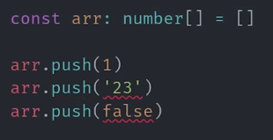
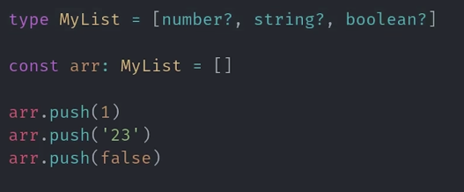
Strong typing arrays/lists
Notes:
this is how you strong type an array
to implement a tuple, where different elements in the list have different types, we do so by having a custom type like MyList
by specifying “?” next to a type, we make it optional, we use this a lot in function parameters

Slide 14
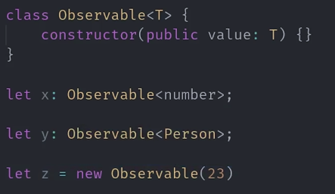
Generics
Notes:
when you want to use a specific type internal to a class, for example, consider Oberservables in react
Observables are used to monitor any type of data variable, T specifies the type of variable so we can strong type the Observable
we’ve just generically specified T so that in the later point of code, we can specify the type we want

Slide 15
Experiment with TS
Create a react typescript app
Check the contents in the project
Run the app
Create new components
Add props with types

